Slide 1
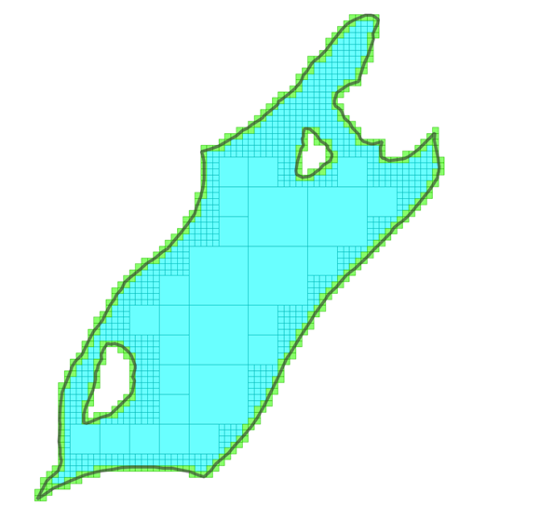
RADIG: Resolution-Adaptive Digit Interleaving Grid for multi-resolution grid index
Sheng Zhou and Jonathan Simmons
Data Science & Geospatial Insights
Ordnance Survey

Slide 2
Spatial Index: In Memory, In Database, or In Data
Spatial Index: Rapid (O(log(n)) to O(1)) search for related spatial features
Data scale:
Small: in memory for small applications
Medium-Large: DBMS with secondary storage + in-memory acceleration
Large: Embedded in data in the cloud
Architectures
Data-Driven: R-tree, Quadtree etc (with internal structure on the storage system)
Grid-Based: easy to embed index in data and support for better interoperability

Slide 3
Grid-Based Hierarchical Spatial Index and Index Embedding
Grid-Based Hierarchical Spatial Index
Partition space into grid cells in a hierarchy by pre-defined scheme
Example: HTM (Hierarchical Triangulation Mesh), GeoHash, H3, …
Triangle, Square, or Hexagon cells
A unique grid reference may be assigned to each cell
This reference may be embedded into data items related to this cell
Some schemes (e.g. HTM, but not H3) are sub-divisive, i.e. a child cell is contained entirely by one parent cell
We may represent the sub-division relationship in references of parent/child cells
“S20”.startsWith(“S2”) is true => cell(“S2”).contains(cell(“S20”)) is true
S22
S2
S23
S20
S21

Slide 4
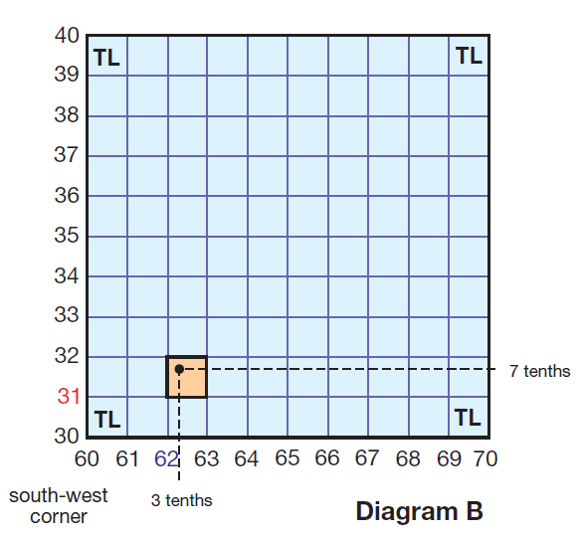
BNG grid reference as a spatial indexing method
Example: TL623317 with encoded information:
Location (bottom-left corner of the cell: 5623000E 2317000N)
Resolution (size of the cell: 1000m by 1000m)
Indexing: any feature related to the cell may quote the reference for indexing
Usage: two features quoting the same reference are potentially related spatially
BNG is sub-divisive, but BNG references do not represent the sub-division relationship

Slide 5
A Better BNG?
What an ideal BNG reference scheme could offer:
Indexing different features in a dataset at different resolution according to the size of the feature
Indexing a feature with multiple references at different resolution to adapt to the shape of the feature and improve space utilisation
Deducing spatial relations (intersection, containment, etc.) of cells at different resolution from their cell references

Slide 6
Resolution-Adaptive Digit Interleaving Grid (RADIG)
A framework to tackle the multi-resolution grid reference problem
Offers a protocol to define custom encoding systems (number-base, length of coordinate string, dimension, etc.)
A dual divisor scheme to increase granularity if required (mapping one digit in source coordinate into two digits in reference string)
Joining two datasets with references at mixed resolutions (provided they are indexed under the same RADIG scheme)
Using Digit Interleaving encoding to represent resolution hierarchy in reference string so that parent reference is a prefix of child references

Slide 7
Digit Interleaving: BNG vs RADIG as a practical example
A sample BNG coordinate: 562356, 231722
BNG Grid references at different resolution (interleaving + concatenation) : TL->TL63->TL6231->TL623317-> TL62353172->TL6235671322
RADIG aligned to BNG and using digit interleaving encoding: TL->TL63->TL6321->TL632137->TL63213752->TL6321375262
Digit Interleaving: 5 6 2 3 5 6, 2 3 1 7 2 2 Digit Concat: 5 6 2 3 5 6, 2 3 1 7 2 2
RADIG Ref: T L 6 3 2 1 3 7 5 2 6 2 BNG Ref: T L 6 2 3 5 6 3 1 7 2 2

Slide 8
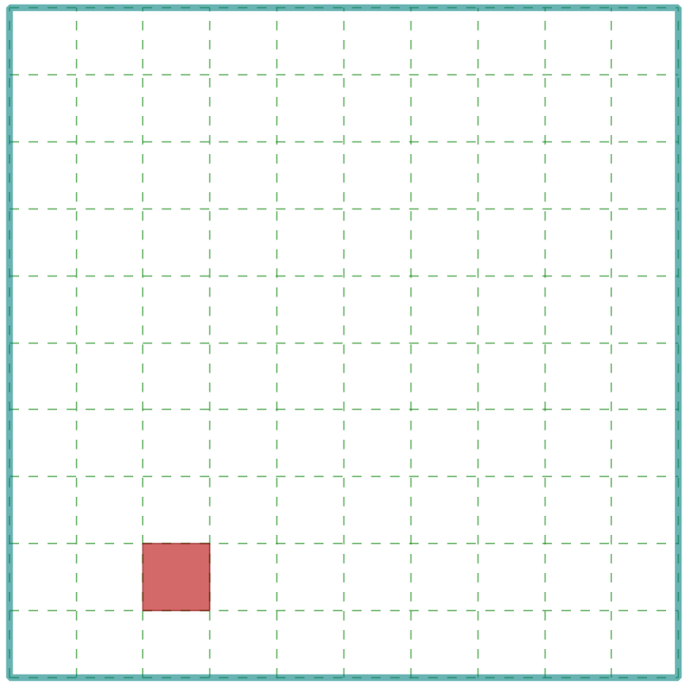
Digit Interleaved RADIG Reference for Multi-Resolution Process
Grid cell hierarchy represented by the order of digits in digit interleaving references:
Ref Series for (562356, 231722): TL->TL63->TL6321->TL632137->TL63213752->TL6321375262
Grid_Cell(TL).contains(Grid_Cell(TL63)) <=> “TL63”.startsWith(“TL”) == True
Grid_Cell(TL63).contains(Grid_Cell(TL6321) <=> “TL6321”.startsWith(“TL63”) == True
And so on…
Original BNG: TL63 vs TL6231 (not prefixing)
TL63
TL6321

Slide 9
Grid Cell Containment/Intersection by Prefixing Operations
Containment
containDF = dfFeat.join(dfQry, dfFeat.RadigRef.startsWith(dfQry.RadigRef))
Intersection
interDF = df1.join(df2, df1.RadigRef.startsWith(df2.RadigRef) | df2.RadigRef.startsWith(df1.RadigRef))

Slide 10
Dynamic Generation of Grid References Adaptive to Feature Extent
Polygon feature as an example
Start at a large initial resolution (equal or larger than the extent of the feature)
May use the lower bound instead (the next resolution smaller than the extent)
Test “effective area” value (proportion of cell intersecting the feature)
If ratio higher than predefined threshold, return the reference of this grid cell
Otherwise, sub-divide the cell, goes to next finer resolution to repeat the test
May also be controlled by a cut-off minimum resolution, and a maximum levels of sub-division

Slide 11
Flow Chart for RADIG Reference Generation
Pure digit-string output
BNG-style as a customised instance
Support encoding in different radix number systems (e.g. base10, 2, 8, 16)
Currently implemented in Java, with Scala wrappers for Databricks
Further details in the technical report
Encoding prefix
Dual Divisors to improve resolution granularity and support the 5x tiles
Grid Spec.
(G, B, I, D)
geometry
Acquire Initial Resolution and generate RADIG
Test Cell-geometry intersection
Intersects?
N
Recycle cell
Y
Compute EA/EL
Result
Output reference
N
Above threshold or not reaching level/res limit
Y
Cell sub-division

Slide 12
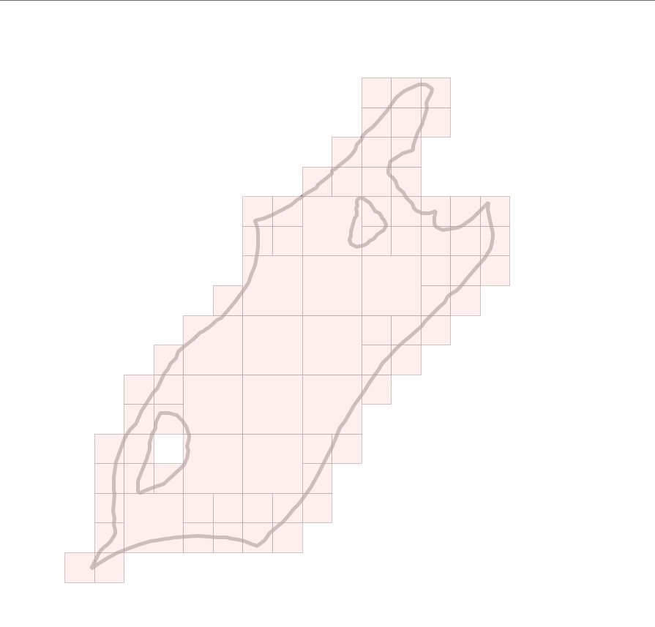
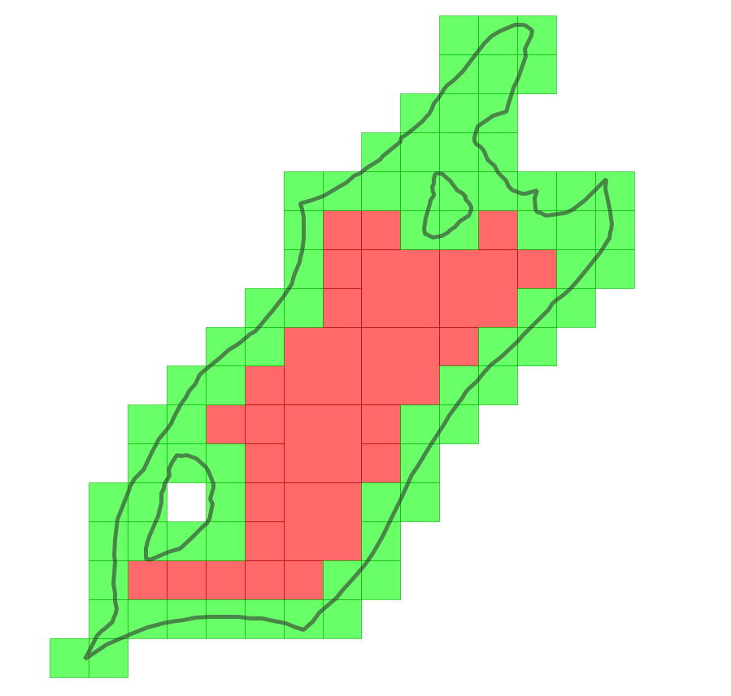
Sample RADIG Outputs (1)
Base-10, 2 divisors (2X5), max level 4, area ratio 0.8
Base-10, divisor 2x5, max level 4, area ratio 0.8, containing cells are separated

Slide 13
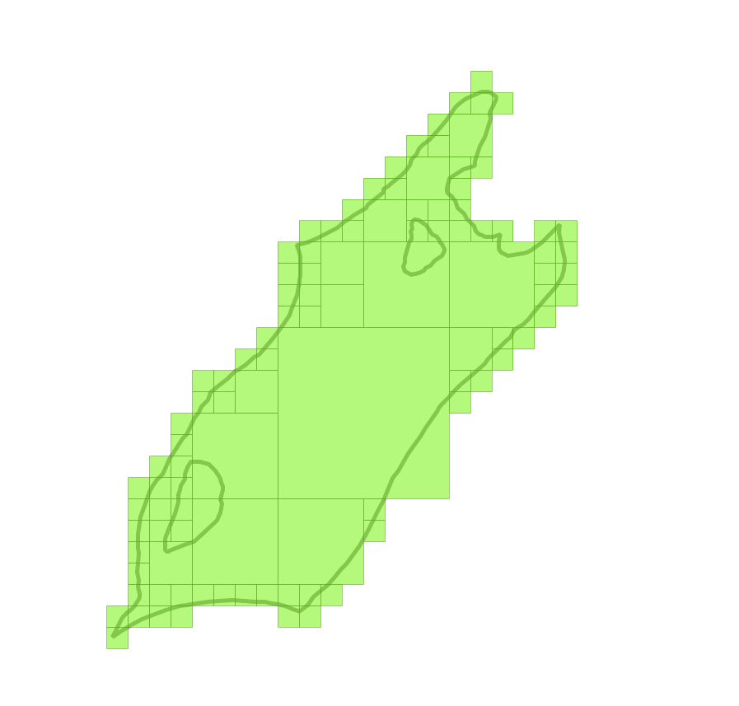
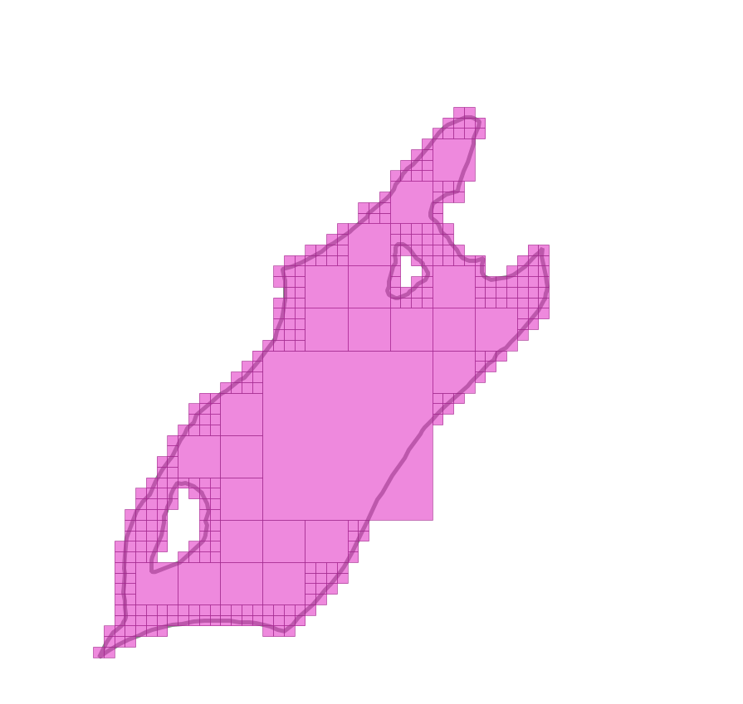
Sample RADIG Outputs (2)
Base-10, max level 5, 2x5 divisor
Base-2, max level 6
Base-16, max level 4, 4x4 divisors

Slide 14
Prefixing: Performance Issue
StartsWith()
Many DBMS don’t have it yet
Some have it, but not optimised
In Spark SQL, the call is translated to a full cross-join (O(M*N))

Slide 15
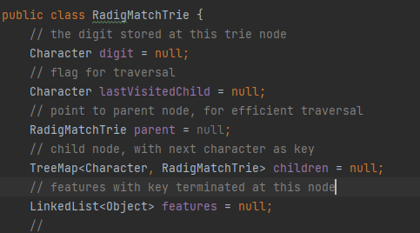
Multi-Way Trie for RADIG Reference Matching
…
S
T
U
…
…
G
L
M
…
Trie (a.k.a. Prefix tree):
Data structure for sequence matching, common sequence, etc.
RADIG Reference Matching
Example: TL6321375262
…
5
6
7
…
…
2
3
4
…
…
1
2
3
…
…
0
1
2
…
…
2
3
4
…
…
6
7
8
…
…
4
5
6
…
…
1
2
3
…
…
5
6
7
…
…
1
2
3
…

Slide 16
Querying a RADIG Match Trie
…
S
T
U
…
…
G
L
M
…
Given query reference TL6321
Drill down from top of the Trie per digit
First matching node (red cycle) and all its children (inside the dashed box) are the result
…
5
6
7
…
…
2
3
4
…
…
1
2
3
…
…
0
1
2
…
…
2
3
4
…
…
6
7
8
…
…
4
5
6
…
…
1
2
3
…
…
5
6
7
…
…
1
2
3
…

Slide 17
Synchronised Traversal for Joining Two RADIG Tries
curL = rootL,
curR = rootR
Y
Retrieve matched ref from curR
Depth-first traverse on the left Trie, visit the corresponding node on the right trie simultaneously
Time complexity: O(a*m*N) (a: the ave. key length; m: the alphabet size; N : the max Trie size)
curL is terminal?
curL = childL
curR = childR
N
N
Y
childL = curL.getNextChild
childR is null?
N
childR = curR.parent.getNextChild(childL)
childL is null?
curL == rootL?
Y
End
Y
curL = curL.parent
curR = curR.parent
N

Slide 18
Scalable RADIG Match Trie - The Method
Two tries to be compared must cover the same key space
Partition is required for large dataset
Partition and Conquer: two approaches
Object-based Partition (Think B-tree/R-tree/BSP)
Build trie on one dataset and generate even partitions of key space (complicated)
More adaptive to unbalanced data distribution but online partition computation may be required for one dataset
Key space Partition (Think Grid/Quadtee) – the choice of our current implementation
Use regular grid cells as partition
Simple, easy to pre-compute partitions on both datasets

Slide 19
Scalable RADIG Match Trie - The Process
Select a partition scheme (e.g. 10k grid with unique ID for each cell)
Assign partition IDs to features in both dataset (features may have multiple IDs)
In both dataset, group features by partition ID
Join two datasets by partition ID
For each row in joined dataset, build RADIG match tires and match features
De-duplicate and output result

Slide 20
Mosaic vs RADIG: Running Time
Mosaic: Geospatial library from Databricks, supporting H3 and BNG
Two datasets have to be indexed at the same resolution
Dataset: 40298590 address points vs 14767492 building polygons (Z-Order optimised when applicable)
Mosaic: ave. 1.81min (by String equality test)
RADIG Match Trie: ave. 4.51min

Slide 21
Discussion
RADIG is slower than Mosaic (understandable with all the data structure overheads) but still at the same magnitude - a price worth paying for flexibility and interoperability.
With RADIG Match Trie, we can now claim RADIG is ready for practical use, especially for dataset of features with huge size variation, and for easy inter-operation.
Please refer to our paper and GitHub repo for more details

